Slide 1

Credit EDA
Case study

Slide 2
Problem Statement
“Loan providing companies find it hard to identify who is eligible for loan reimbursement and who is a defaulter.”
Two types of risks are associated with the bank’s decision
1
2
If the applicant is likely to repay the loan, then not approving the loan results in a loss of business to the company
If the applicant is not likely to repay the loan, i.e. he/she is likely to default, then approving the loan may lead to a financial loss for the company.

Slide 3
Types of decisions
Approved: The Company has approved loan Application
Cancelled: The client cancelled the application sometime during approval. Either the client changed her/his mind about the loan or in some cases due to a higher risk of the client he received worse pricing which he did not want.
Refused: The company had rejected the loan (because the client does not meet their requirements etc.).
Unused offer: Loan has been cancelled by the client but on different stages of the process.

Slide 4
Analysis – Stepwise
1. import | 2. Data structure | 3. Check & find missing values | 4. Checking for outliers
Importing all the necessary libraries | Examining application data | Check Data quality and find the Missing Values for both the dataframe | Plot the Box Plot for all the variables necessary
Read dataset from local | Examining previous application data | Dropping columns where missing values are greater than 40% from application data and 20% from previous application data | -
- | - | Imputation of values for columns where missing values are less than around 13% from application data | -
- | - | Removing the unwanted columns

Slide 5
Analysis – Stepwise (contd…)
5. Identify Data imbalance | 6. Univariate analysis | 7. Bivariate analysis | 8. Merge
Distribution of target variable | For numerical variables | Numerical - numerical bivariate analysis | Merging the application data with previous application data
Creating new dataframe for target 0 & target 1 | For categorical variables | Categorical - categorical bivariate analysis | Check the percentages of each type of contract status
Ratio of data imbalance | - | Numerical – categorical bivariate analysis | -
Find 10 correlations for both the data sets | - | -

Slide 6
ANALYSIS
Detailed w/ graphs

Slide 7
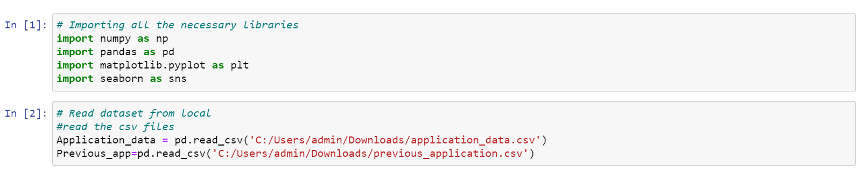
1. IMPORT
Import numpy, pandas, matplotlib and seaborn libraries and read the CSV files.

Slide 8
2. DATA STRUCTURE
Check the data structure by using following functions:
head () - method is used to return top n (5 by default) rows of a data frame or series.
Shape() - The shape property is usually used to get the current shape of an array
Info() - info() function is used to get a concise summary of the dataframe.
describe() - describe() is used to view some basic statistical details like percentile, mean, std etc. of a data frame or a series of numeric values.

Slide 9
3. CHECK & FIND MISSING VALUES
# checking the percentage of null values
# drop the columns where missing values are greater than 40% from application data
# after dropping the columns with missing values greater than 40% we will be left with 73 columns
# check the N/A value in rows greater than 50%
# repeat the same steps for previous application dataset

Slide 10
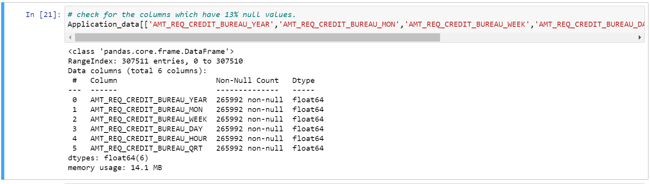
3. CHECK & FIND MISSING VALUES (contd…)
Imputation
# check the data again to find the columns which have null values less than or equal to 13%.
After finding all the unique values for these columns, we can see that these variables indicate number of days, hrs, months, etc. we can conclude that these are columns with categorical values.
Solution for imputing the null values: Since these are categorical columns, and there mode value is 0 for all these variables. so, it is safe to impute the null values with 0.

Slide 11
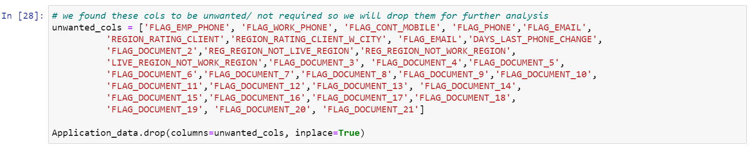
3. CHECK & FIND MISSING VALUES (contd…)
Dropping the unwanted Columns
As we can see there are lot of columns which we don’t require for further analysis; we will drop all these columns

Slide 12
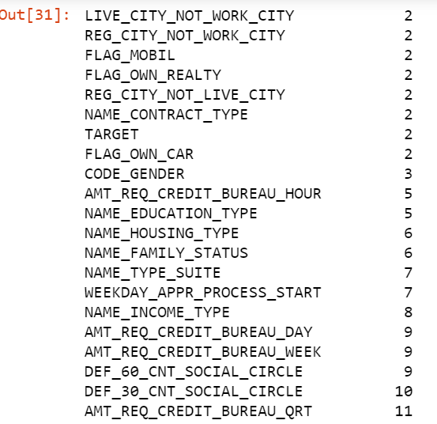
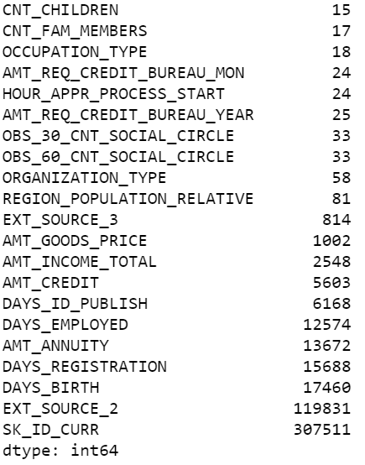
3. CHECK & FIND MISSING VALUES (contd…)
Changing the data type
As we can see till variable ORGANIZATION_TYPE all variables are categorical, so we will get their index and convert them to categorical columns

Slide 13
3. CHECK & FIND MISSING VALUES (contd…)
Covert variable to object datatype
As we can see SK_ID_CURR is int data type, but it has id number of customers, and this variable cannot be manipulated, so we will convert it to object datatype
Negative values
We notice that "DAYS_BIRTH" 'DAYS_EMPLOYED' 'DAYS_REGISTRATION' 'DAYS_ID_PUBLISH' columns have negative values, which is not possible so we will try to correct it by using abs() and convert the days into year and rename this column accordingly.

Slide 14
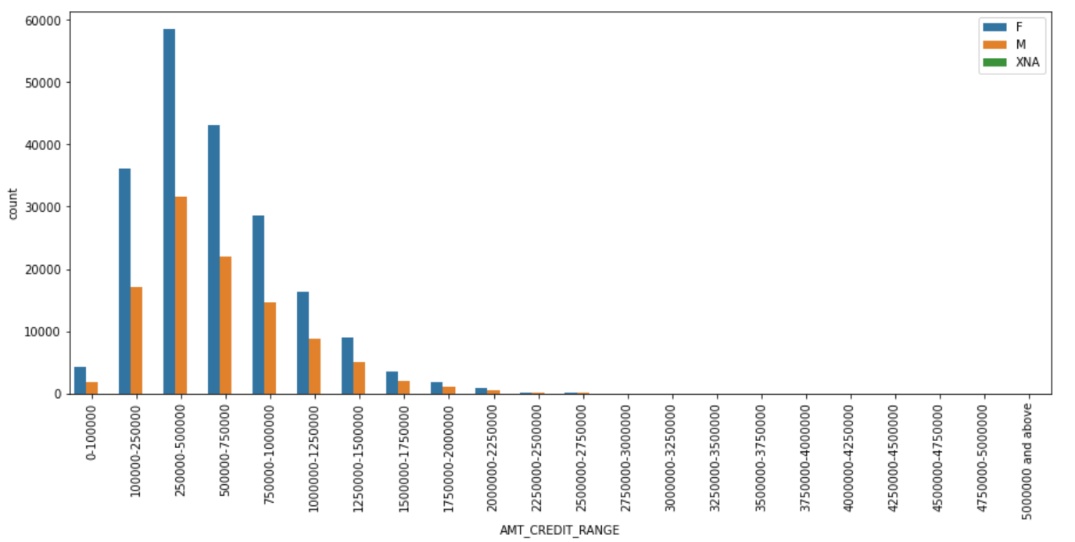
3. CHECK & FIND MISSING VALUES (contd…)
The gender column has 4 N/A values so we can substitute N/A with female as the female count is way more than male so it is not going to affect analysis.
We will now check the 'AMT_INCOME_TOTAL' and 'AMT_CREDIT' variables as it is hard to determine the type of customer based on these values as these are continuous. So we will make 2 new columns for these respectively dividing them into categories for further analysis.
* From the graph it is evident that females take more credit loan as compared to male which is in the range of 2.5 to 5.0 lakhs.

Slide 15
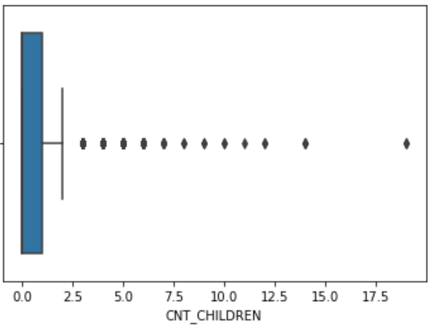
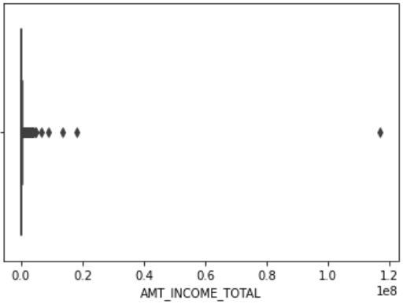
4. CHECK FOR OUTLIERS
This variable indicates Number of children the client has.as we see from the plot some values are as high as 19, which is not possible in general case scenario. hence we can consider it as an outlier
This variable indicts the Income of the client, as we can see from the plot there is one value which is too high compared to others, hence we can consider it as an outlier

Slide 16
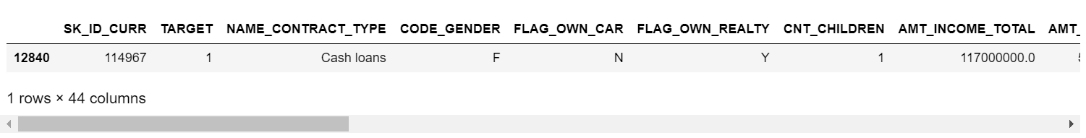
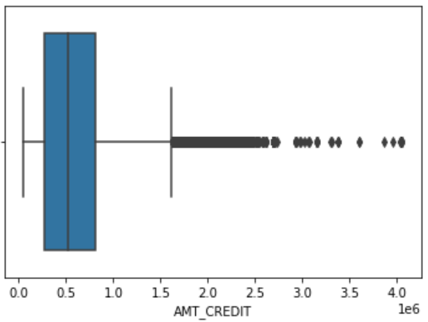
4. CHECK FOR OUTLIERS (contd…)
#this output proves that it is an outlier since the person here has occupation type as laborer, and her target variable is 1.
# this variable indicates Credit amount of the loan and we can see from the graph there are few outliers. We will check these values to confirm.
# the AMT_CRDIT is greater than AMT_INCOME_TOTAL in all the cases which should be taken care of as it will effect the business negatively as it will create more bad loans.

Slide 17
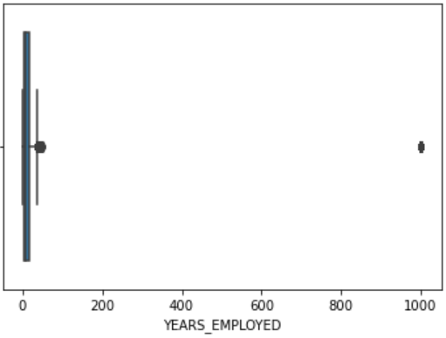
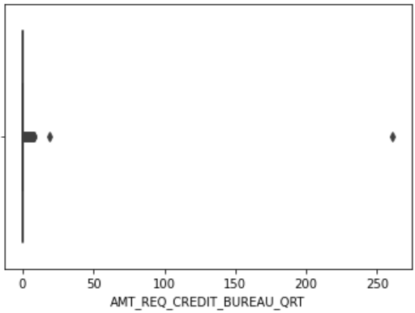
4. CHECK FOR OUTLIERS (contd…)
#this variable indicates How many years before the application the person started current employment, as we can see from the plot below with a value 1000 yrs. which is surely not possible so we can consider it as an outlier.
#this variable indicates How many years before the application the person started current employment, as we can see from the plot below with a value 1000 yrs. which is surely not possible so we can consider it as an outlier.

Slide 18
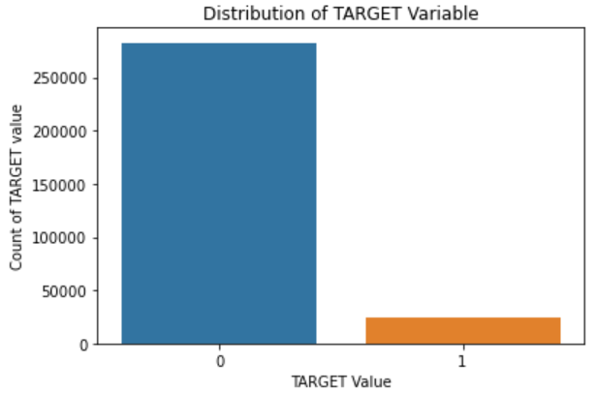
5. IDENTIFY DATA IMBALANCE
Now we are going to divide the application dataset into two different dataframes based on target variable's value.
appli_data_target0 and appli_data_target1 for values 0 and 1 respectively
check for imbalance of data
so basically the ratio of 0:1 is 11.387:1 this indicates that for every 1 there are almost 11 number of 0's. this is a highly imbalanced data set

Slide 19
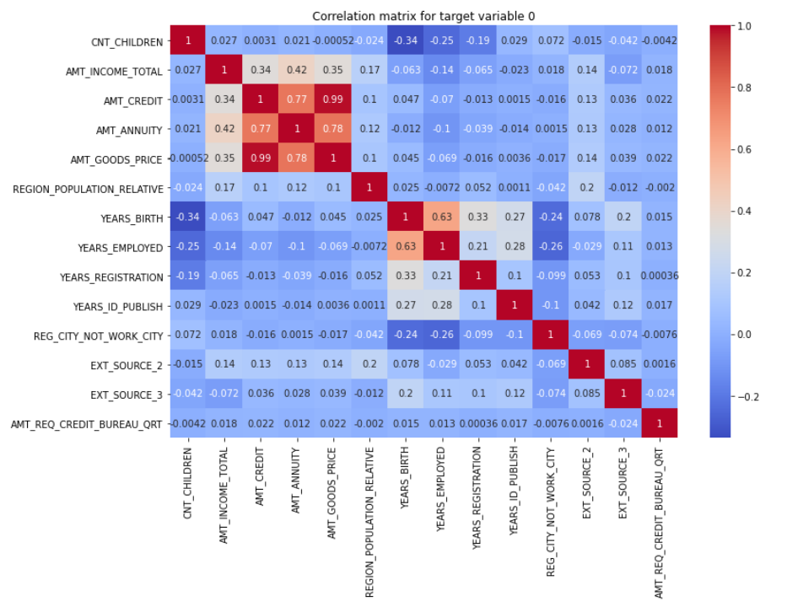
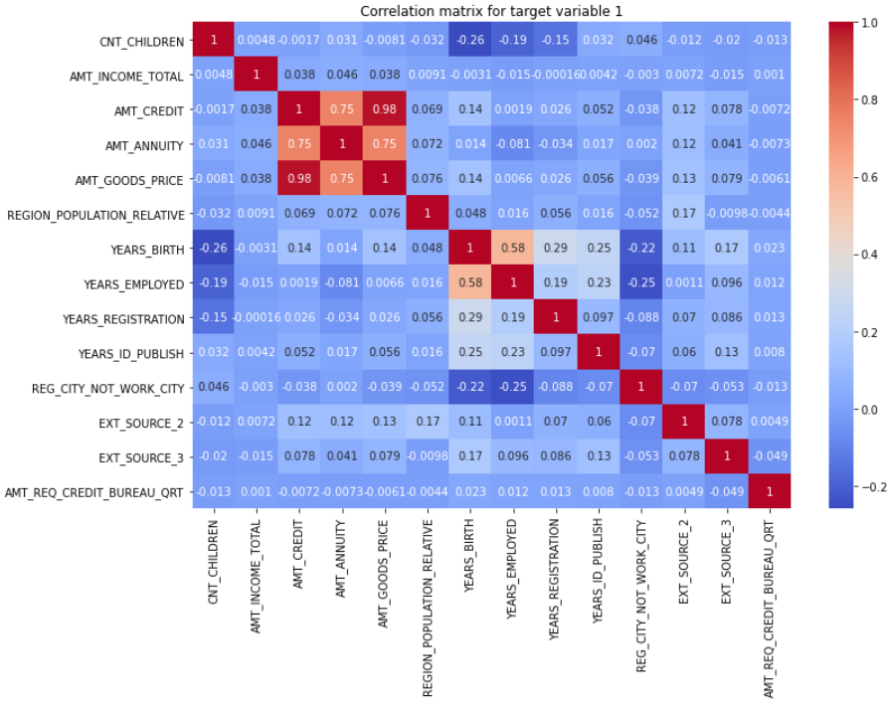
5. IDENTIFY DATA IMBALANCE
Correlation matrix for target variable 0
Correlation matrix for target variable 1
**Note: As we can see from the top 10 correlations from both the dataframes, the top 3 correlations for both are almost similar.

Slide 20
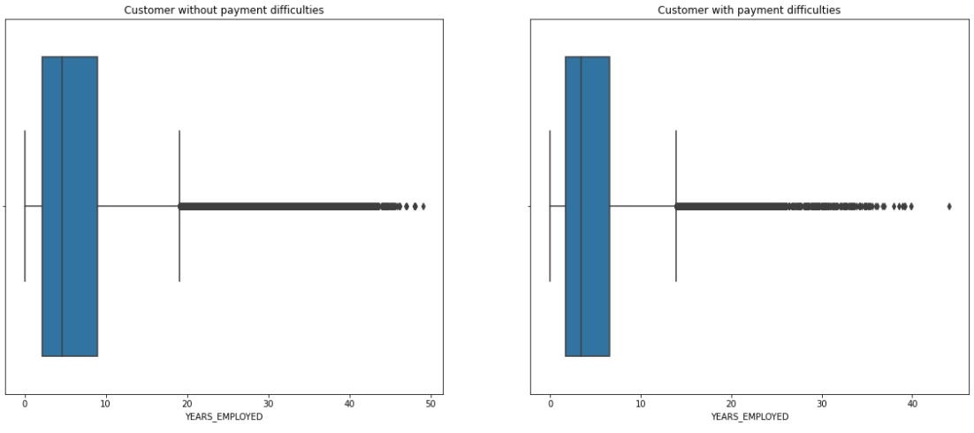
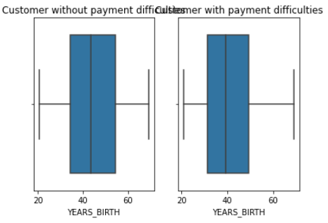
6. UNIVARIATE
For numerical variables
From the above boxplot we can note that customer without payment difficulties having age between 34 to 54 years, and customer with payment difficulties are in between 31 to 50 years.
From the above box plot we can note that customer without payment difficulties having year of employment in between 34 to 54 years, and customer with payment difficulties having in between 31 to 50 years.

Slide 21
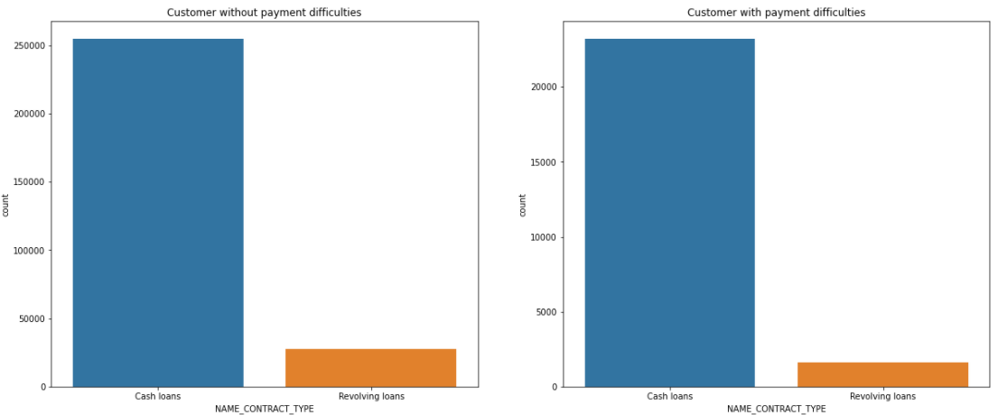
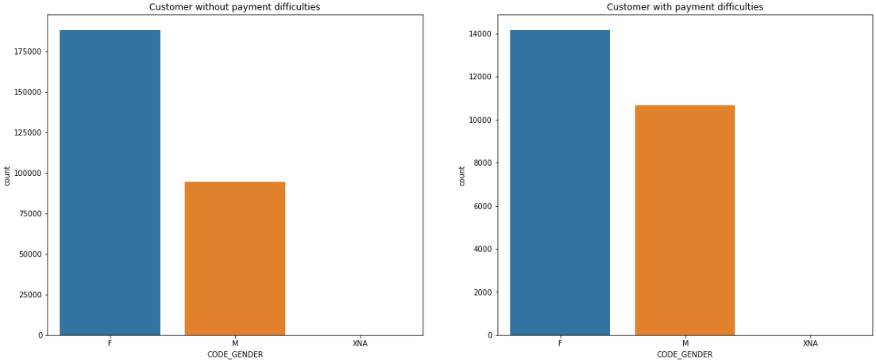
6. UNIVARIATE (contd…)
For categorical variables
From this plot we can see that the customer without payment and customer with payment difficulties both are taking cash loans.
Here we can see that the female customer is having highest count with payment difficulty as compare to male customers.

Slide 22
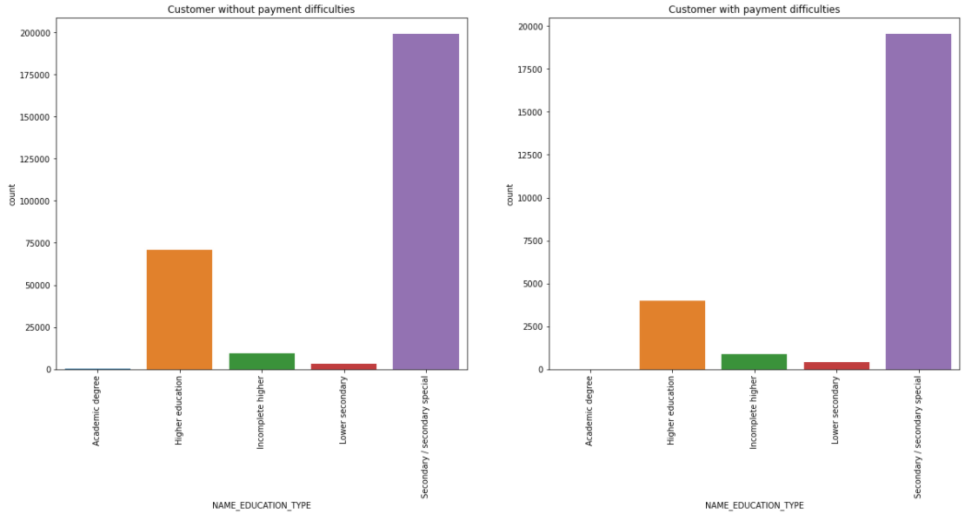
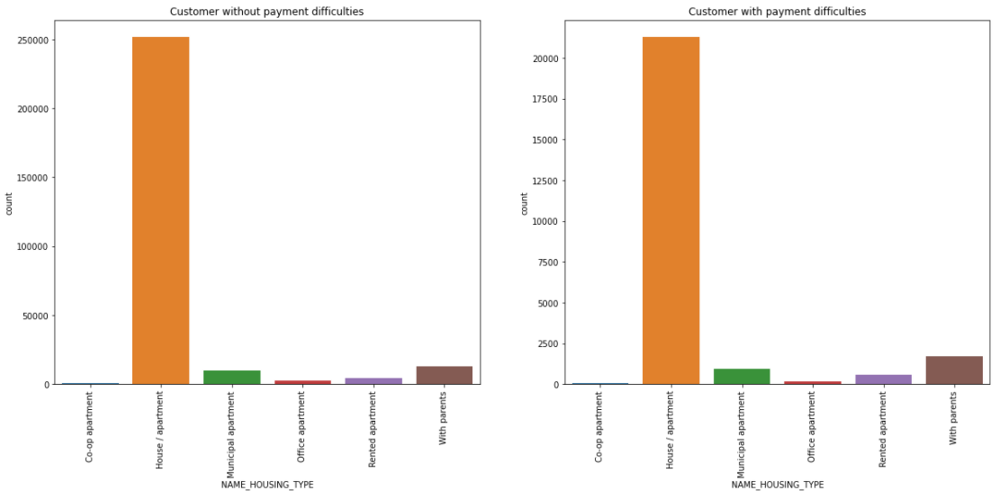
6. UNIVARIATE (contd…)
For categorical variables
Here we can see that the customer having higher education has less payment difficulty as compared to the other classes.
Here we have the payment difficulties in home/ apartment in both the cases. people living with there parents have less payment difficulties.

Slide 23
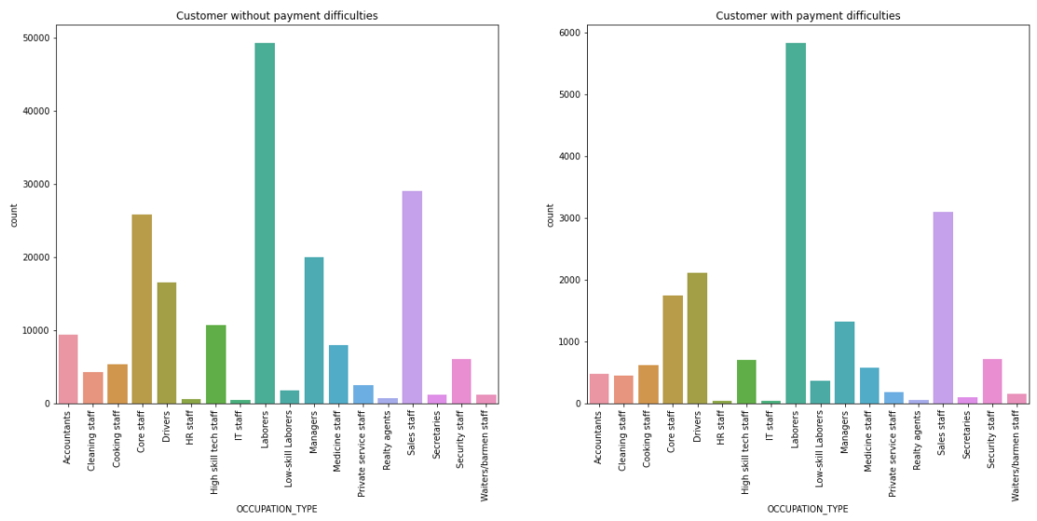
6. UNIVARIATE (contd…)
For categorical variables
Here we can see that laborers are having more difficulties in repaying the loan and also the core staff and the sales staff. But in the case of laborers those wo have without payment is way more then with having the payment

Slide 24
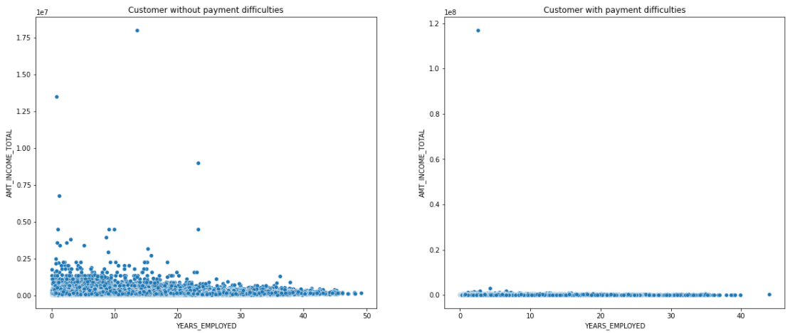
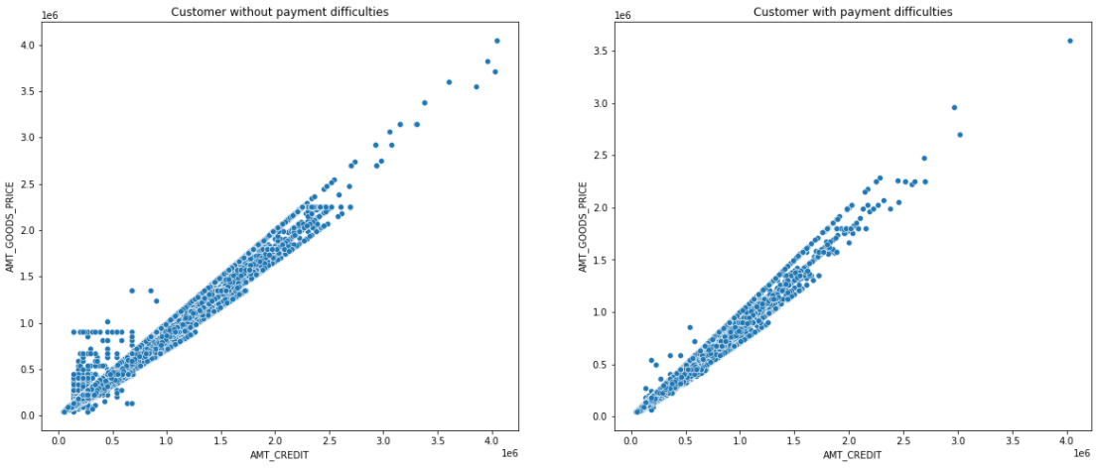
7. BIVARIATE
Numerical-Numerical bivariate analysis
From the scatter plot we can say that customer with working experience and incremental income face less difficulties in loan payments
We can see that goods price is positively correlated with credit amount.

Slide 25
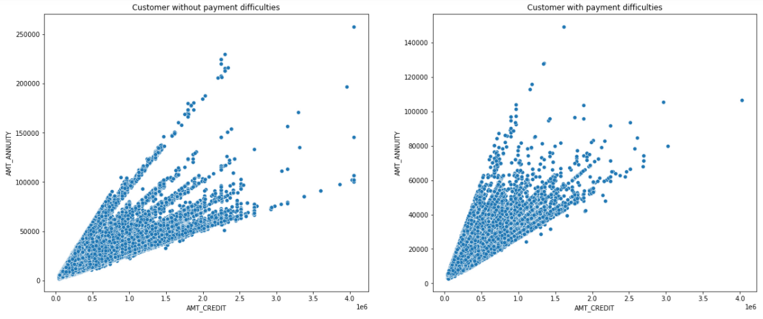
7. BIVARIATE (contd…)
Numerical-Numerical bivariate analysis
People without payment difficulties take more credit for the annuity that they have

Slide 26
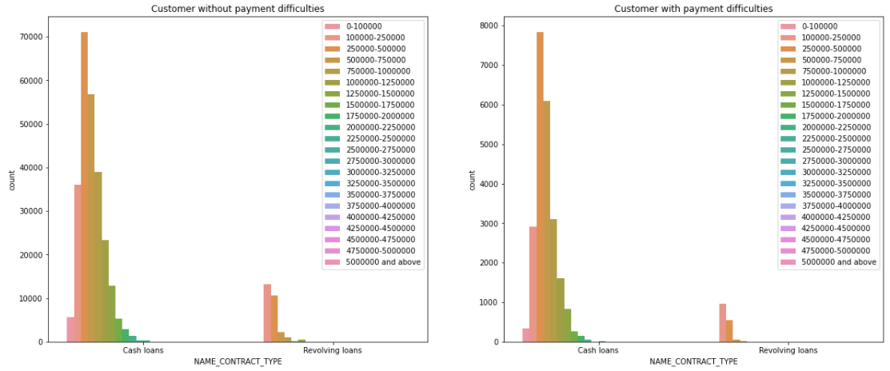
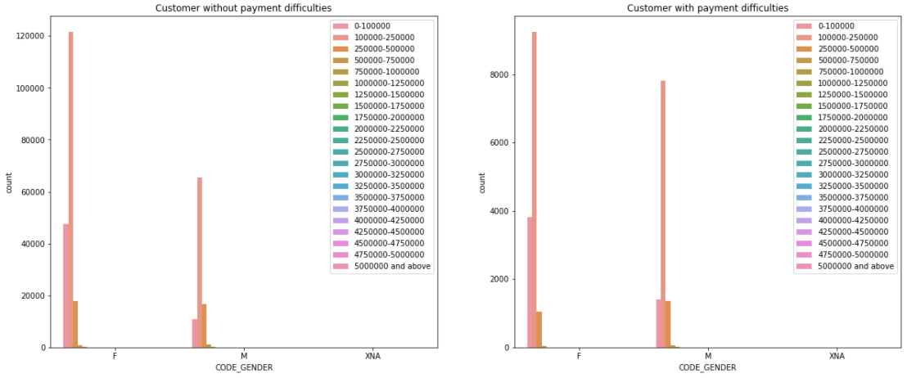
7. BIVARIATE (contd…)
Categorical - categorical bivariate analysis
We can see that most of the customers prefer to take cash loan as compared to the revolving Loans.
We can see that female with more income has less payment difficulties as compared to the female with less income which is true for males also

Slide 27
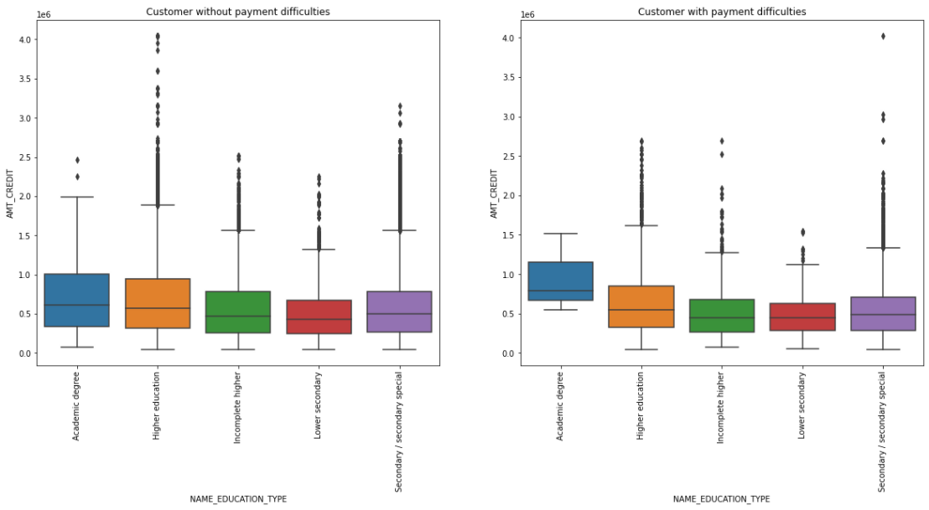
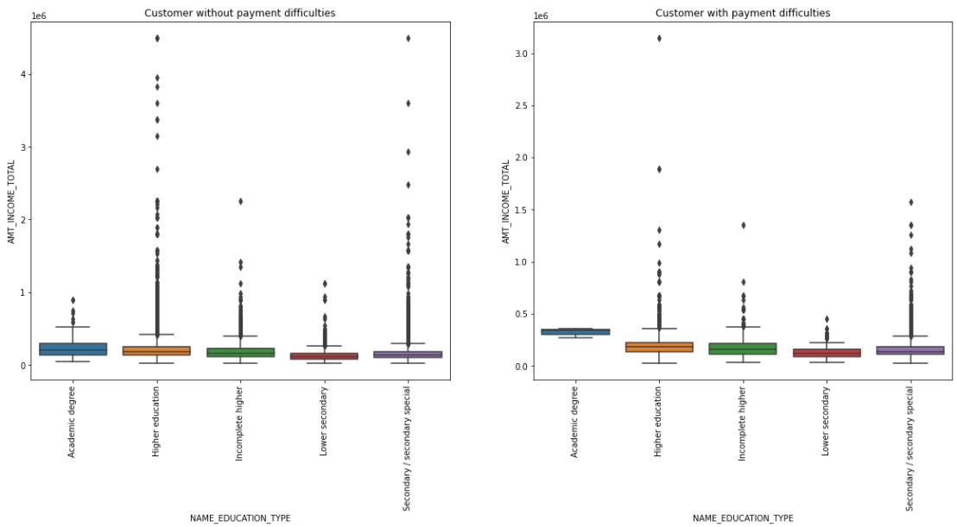
7. BIVARIATE (contd…)
Numerical- categorical bivariate analysis
Here we can see that the range of customers without payment of Academic degree is higher than the customer of with payment. And the rest of the Education type is almost same for both the cases.
Here we can see that the customers without payment difficulties is having more outliers as compare to the customer with payment. we can also say that people with payment difficulties has less income so they tend to default more.

Slide 28
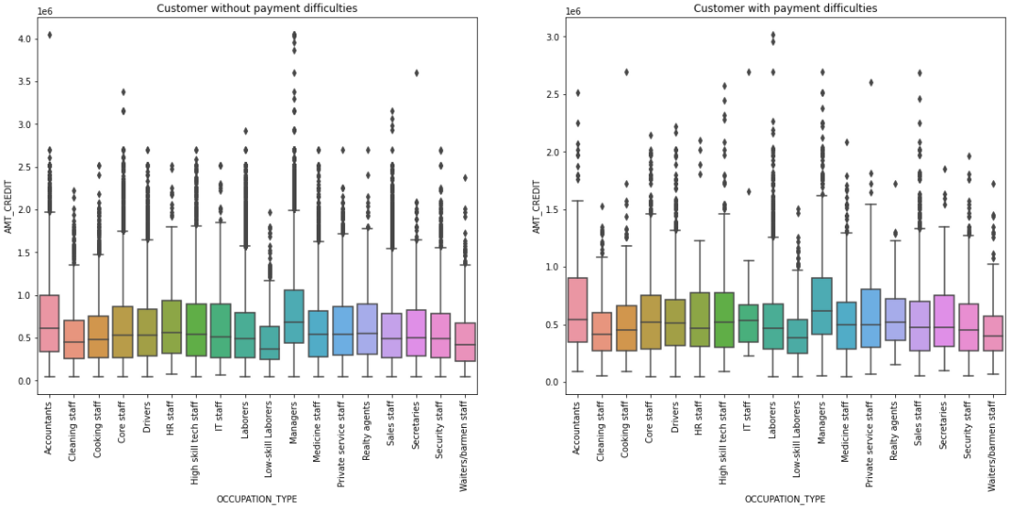
7. BIVARIATE (contd…)
Numerical- categorical bivariate analysis
Here we can see that the range of the customers without payment difficulties is more as compare to the customers with payment difficulties. people with payment difficulties has more outlier.

Slide 29
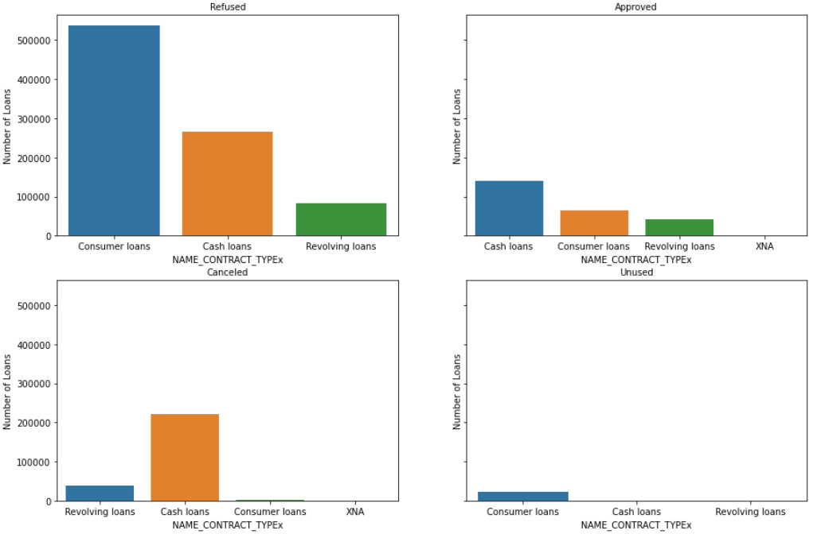
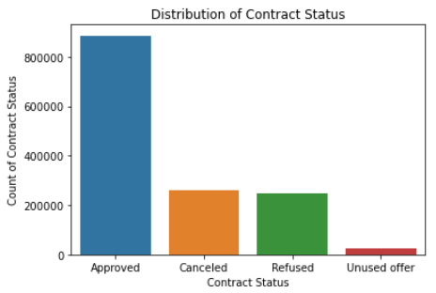
8. MERGE
After merging the data
As we can see there are more no. of approved loans in the data
Here we can see that the Cash loans are the one which are mostly approved as well as cancelled compared to the other categories.
we can also see that consumer loans are the lest used and most refused of all the categories.

Slide 30
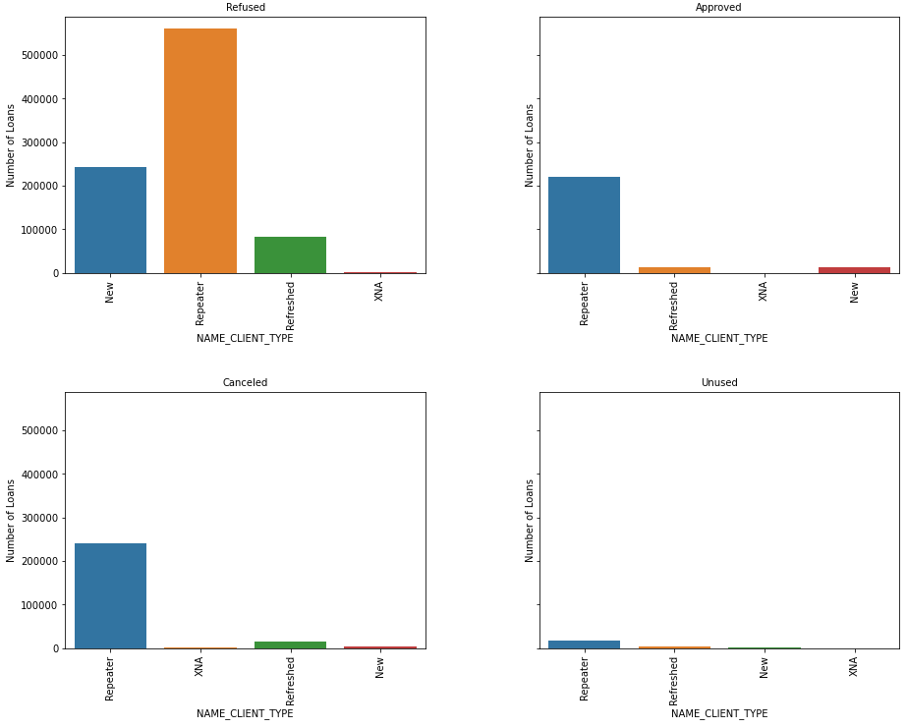
8. MERGE (contd…)
After merging the data
Here we can see that the Repeater is getting more Refused but also we can see that the it also getting more approved and even that it is getting more canceled and more unused.

Slide 31
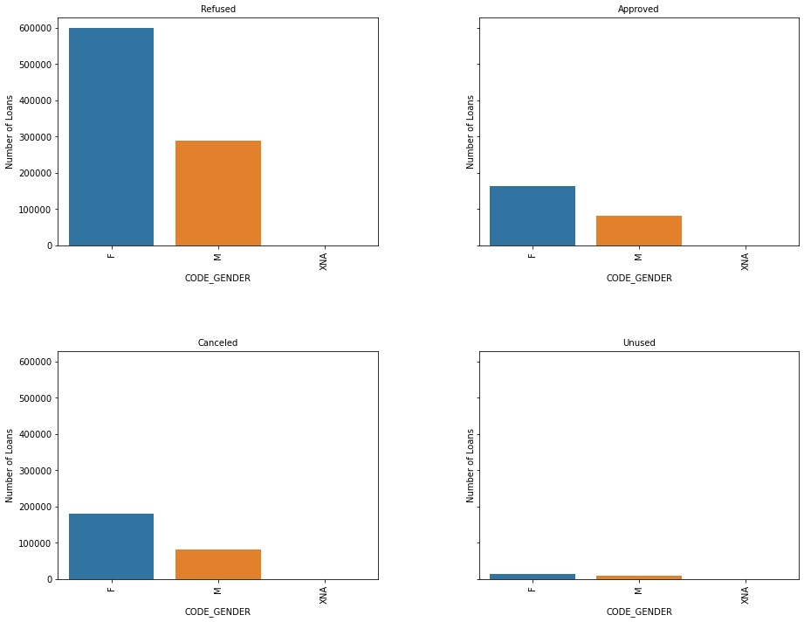
8. MERGE (contd…)
After merging the data
Here we can see that Female is getting more Refused more approved more canceled more unused but in case of male it is having average in every category.

Slide 32
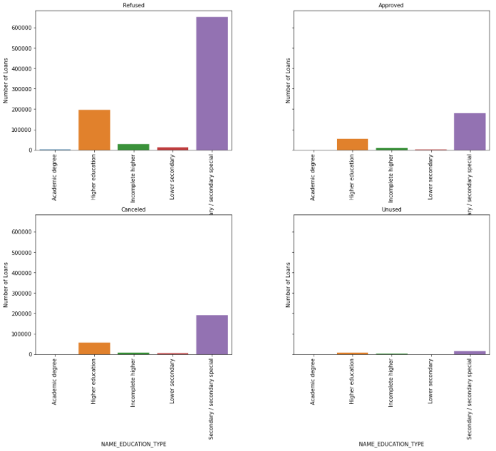
8. MERGE (contd…)
After merging the data
Here we can see that Secondary/ Secondary special is more effective in every case

Slide 33
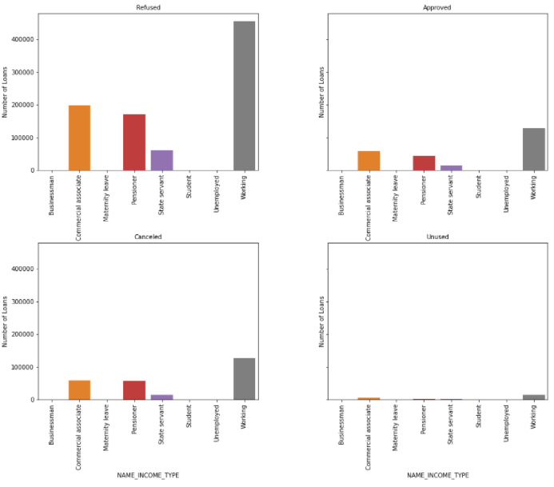
8. MERGE (contd…)
After merging the data
Here we can see that the working type people are applying more loans as compare to others.

Slide 34
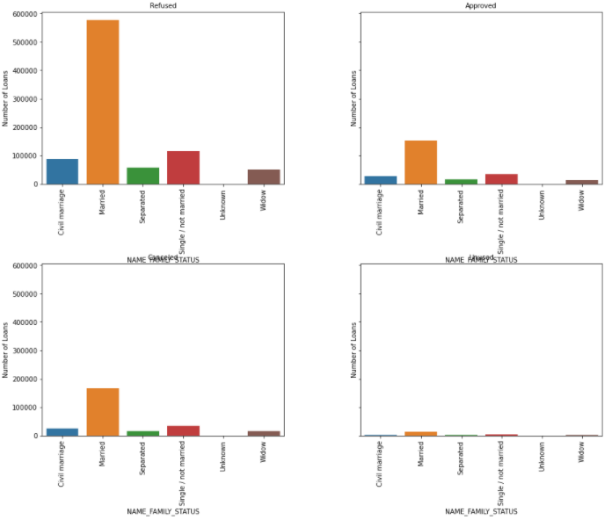
8. MERGE (contd…)
After merging the data
Here we can see that the Married people are applying and taking loans more than the others and having more counts in all the status.

Slide 35
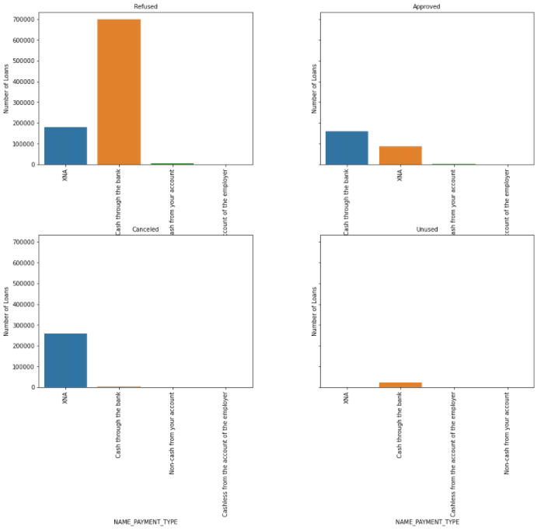
8. MERGE (contd…)
After merging the data
Here we can see that the people are taking more loan in format of cash through the bank.

Slide 36
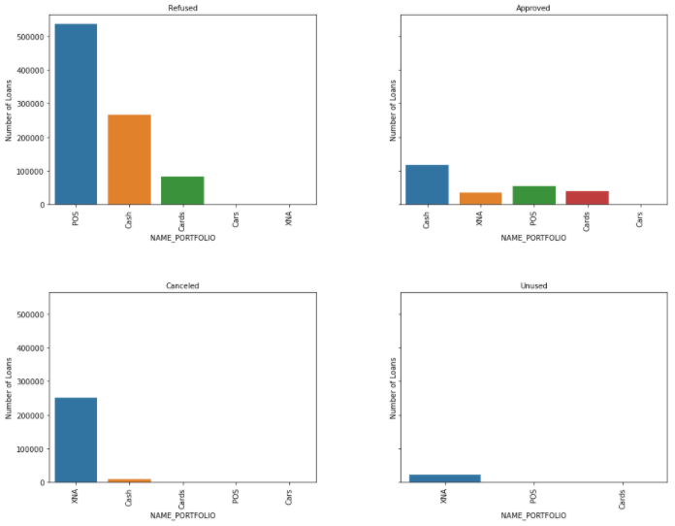
8. MERGE (contd…)
After merging the data
Here most approved loan were through cash and Most refused loans were in POS.

Slide 37
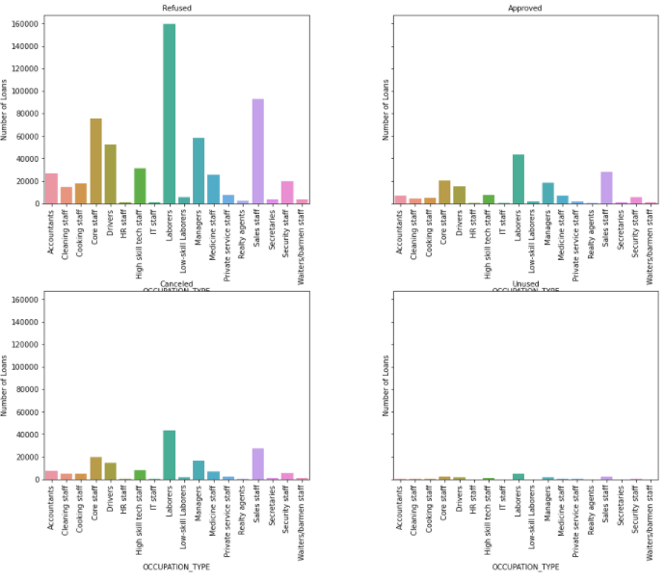
8. MERGE (contd…)
After merging the data
Here laborers are getting most refused and most approved loans. And also Sales staff is also getting the second most refused and approved loans.

Slide 38
CONCLUSION
Banks should focus more on contract type ‘Student’ ,’pensioner’ and ‘Businessman’ with housing ‘type other than ‘Co-op apartment’ for successful payments.
Banks should focus less on income type ‘Working’ as they are having most number of unsuccessful payments.
The bank lends more to female customers.
More cash loans go into default, bank should give more revolving loans.
People with higher education default less.
Married people default less.
Loan previously refused or cancelled has higher default rate.
Get as much as clients from housing type ‘With parents’ as they are having least number of unsuccessful payments.

